Slide 1
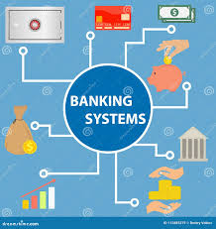

BANK MANAGEMENT
PROJECT PRESENTATION
Telephone
Address
Website
December 2024
0717131147
kevnal456@gmail.com
www.reallygreatsite.com

Slide 2

ABOUT US
WE ARE KEVTECHHH
at kevtech, we are a tech minded company dedicated at coming up with solutions to ensure that there is security and productivity in day to day life. we built financial solutions that are more secure and are user interactive. our products are accesible in remote areas ensuring that banking services can easily be reached by all people even those in remote areas.

Slide 3

WHAT WE BELIEVE
ABOUT OUR VISION AND MISSION
VISION
our vision is to be fintech champions and ensure that banking services are accessed to all people even to those who are in remote areas.
MISSION
Our mission is to deliver solutions that will be able to capture and store data for bank customers create and monitor bank accounts and ensure both efficiency and customer satisfaction.

Slide 4
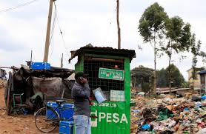
PROBLEMS
WE WILL SOLVE THE PROBLEMS
01
UNAVAILABILITY OF BANKS IN REMOTE AREAS
Many peolpe in remote areas struggle to create bank accounts to facilitate financial transactions. they are forced to travel long distances to cities to have the registration. with this app it will only require a person to register from anywhere even if they are in remote places.
02
HIGH FINANCIAL COSTS AND EXPENSES.
03
SERVICE DELAYS
Customer s from remote places struggle to get financial services due to delay to move to the city. with this app, it will be easy for them to access the services easily.
rregistration of bank accounts from the cities involve alot of cost such as transportation to be able to access the services. Getting to access the bank for services such as checking account balance can be costly if a person from remote area has to travel to town. this app solves the problem as the services are now accessed by this fintech application.

Slide 5
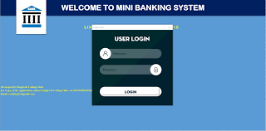
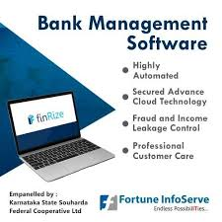

SOLUTIONS
01
CREATING OF NEW ACCOUNT
SOLUTIONS OF THE PROBLEMS
our solution will be able to create the bank account for new users. The user will be able enter the required details to be able to create new accout.
02
DEPOSIT MONEY INTO THE ACCOUNT
Through the provision of the bank account the user will be able to deposit amount of money in the bank account. This will be facilitated by incoporation of mobile service providers to intergrate their services into our service to enable access to mobile wallet.
02
CHECKING OF ACCOUNT BALANCE
the solution will ensure that the customer access services such as checking balances to ensure that his financial records are in order.
Thynk Unlimited

Slide 6
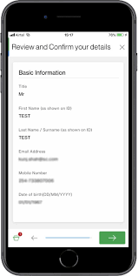

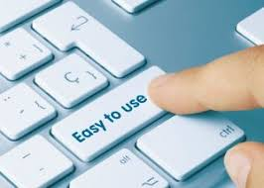
OUR PRODUCT
WHAT WE COULD DO
ACCOUNT REGISTRATION
DATA SECURITY
USER FRIENDLY
Our agency specializes in strategic brand development, ensuring that your brand not only resonates with your target audience but also stands out in a crowded market.
Our data-driven approach ensures data from our customers are well managed and protected.
our agency excels in producing creative, engaging, and impactful financial products that are user friendly

Slide 7
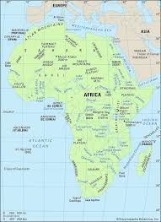
MARKET SIZE
Total Available Market (TAM)
our total market size is the whole of africa, we are targetting remote areas where people are poor and cannot afford additional cost in managing thier bank accounts, with collaboration with banks we can be able to have our technology reach the remote areas.
OUR CLIENTS COME FROM FINANCE SECTOR
Serviceable Available Market (SAM)
our SAM is currently east africa, we are targetting banks and saccos. with this app, we will ensure that cheap financial services are obtained remotely. we will have reduced the cost needed for customers to travel long distances to access bank services in cities and towns.
Serviceable Obtainable Market (SOM)
our SOM is kenya market, we can angage banks and other financial institutions. the simplicity of our app if well adapted, will enable financial institutions reach the remote places and increase customer base. At the same customers will have services at the doorstep thus reducing the cost financial services.
With a africa development goals, our market team have focused on bringing banking at doorstep.

Slide 8

COMPETITORS
01
MOBILE SERVICE PROVIDERS
OUR COMPETITORS
This are mandated to provide communication services to customers. They have introduced mobile money apps that be used on phones .
02
SACCOS
They form a group to ensure that members pool together finances to one saving account. they mostly target population from remote areas who cannot access the financial solutions in cities and towns
.

Slide 9


COMPETITIVE ADVANTAGE
01
ACCOUNT CREATION
we are able to register the bank registration account without a customer having to move to the nearest bank branch.
02
COST SAVING
We save the customer the time and finances needed to move to bank halls or branches to have the registration of the bank accounts.
Thynk Unlimited

Slide 10

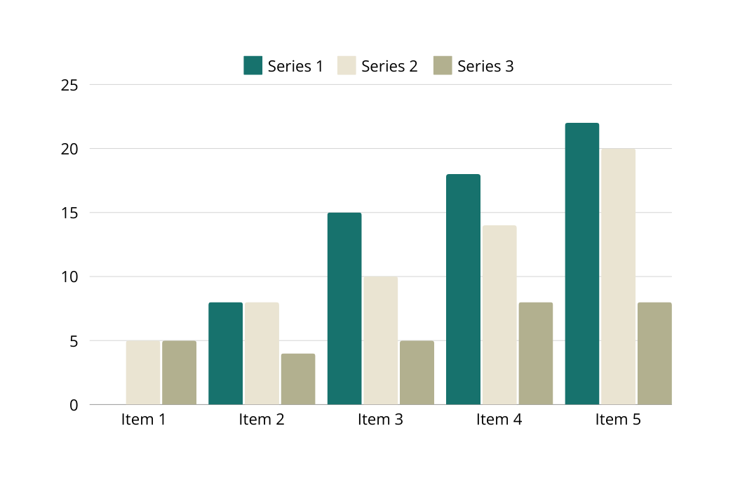
BUSINESS MODEL
OUR BUSINESS MODEL
Our business model thrives on creating a software application which will be sold to the banks and other financial institutions on the subscription with the annual renewals.
we intent to approach banks and saccos who want to increase their customer base by reaching the maginalized areas.
We also intent to reach other stakeholders who can help us build the app and include other functionalities that help us expand to international markets.

Slide 11
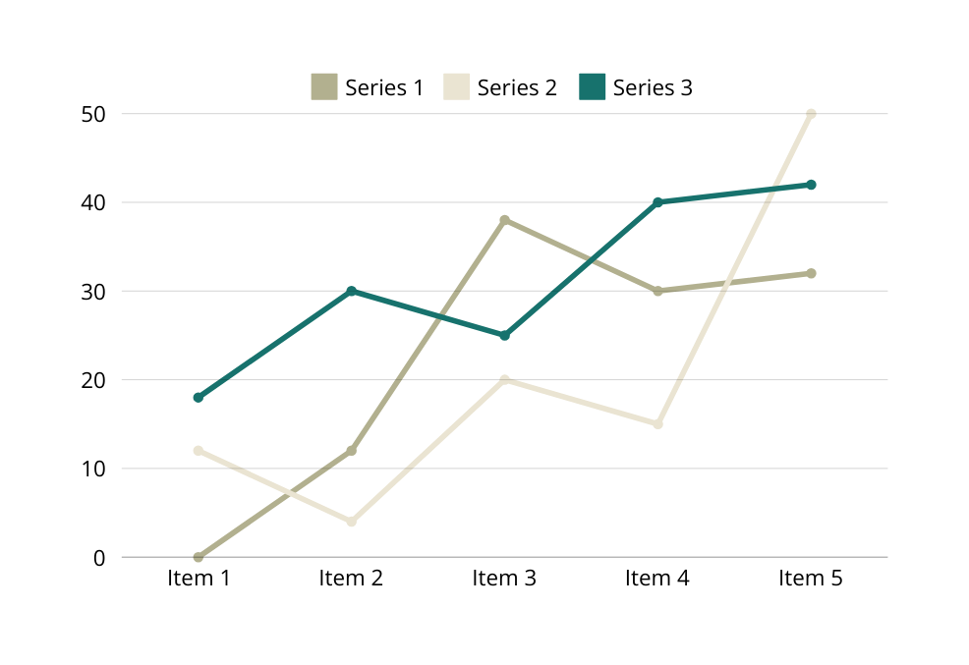
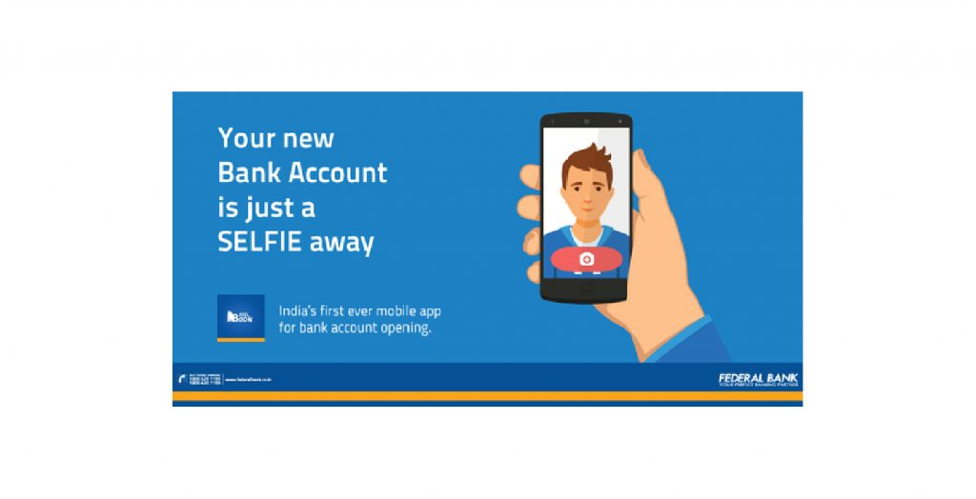
GO TO MARKET
CLIENT’S SATISFACTION
We are reaching the market through printing of bronchures and ditributing them to financial instiitutions such as banks and saccos,
We also do advertisement by publicizing our product on social media platforms.
Reach out to banking institutions.
print bronchours and give them to banks and sacco
angage the public to publisize our products.

Slide 12
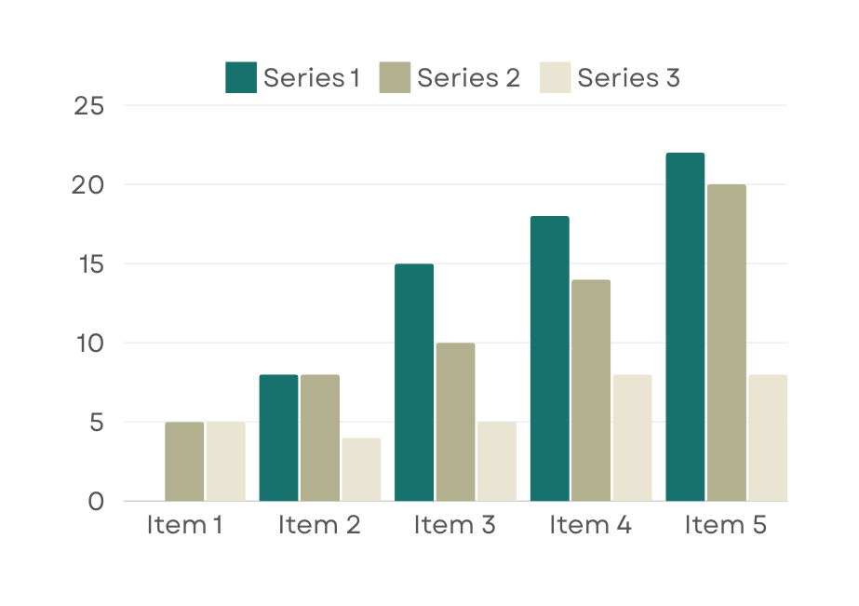
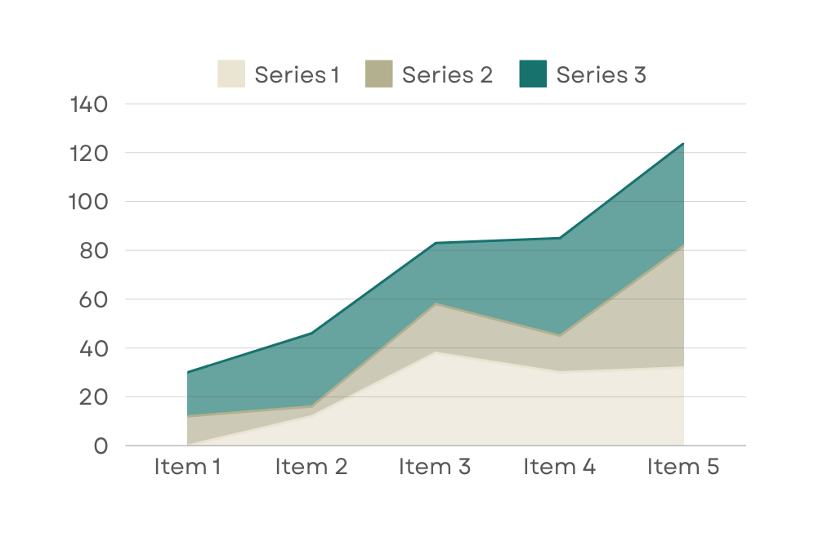
STATISTIC
Our Customer’s Satisfaction
Repeat Order Rate
The clients we have served have given as good feedback, companies that are handling long distance travels have reported improvement in terms of security of their products, and have reported reduced instances related to fartigue and sleep. Also this has ensured that only recognized drivers handle the cars that leading to competence and accountability.
This has let to positive recommendations and refferals leading to more sales and production of more units.

Slide 13

Our ask
$5 MILLION
We are asking for $5 million, to expand our market and production. We indent to use 15% of the money for advertisement, 50% to set up a small manufacturing and sales centre and and to bring on board more expertise and workfore.
$5 MILLION
90% | Our client loyalty speaks volumes as evidenced by a robust repeat order rate
99% | Our paramount focus on client satisfaction is the bedrock of our agency's success.
$5M

Slide 14
THANK YOU
FOR YOUR NICE ATTENTION
Telephone
Address
Website
December 2023
+0717131147
kevnal456@gmail.com
www.reallygreatsite.com

